Slide 1
CONSERVATION OF TRADITIONAL WATER SOURCES OF KERALA
Prof. M.G. Cyriac, Prof. S. Rathish, Prof. Neeraja P.G & Prof. Anju M.J
(Faculty in Civil Engg. Dept., Jyothi Engineering College, Cheruthuruthy, Thrissur)

Slide 2
Main Focus
Maintenance and up keep of wells
Environmental planning of house and the surroundings
Different zones in the state in respect of water pollution potential and remedies
Water treatment options under different conditions
Up keep of water sources against pollution

Slide 3
Conservation
Up keep the usefulness of the sources by all means
Protection of water sources against pollution
Augmentation to ensure source quantity sustainability
Treatment to restore quality , if it is polluted

Slide 4
Traditional water sources
Rivers
ponds
Wells
Bore wells
Filer points

Slide 5
River
Maintaining sufficient flow in the river and also to ensure the quality of river water
Discharge of untreated waste water without properly considering the self-purification capacity of rivers
Sand mining
Excessive usage of river water for domestic purposes
Role of government agencies like that of Pollution control board is predominant
construction of storage facilities in its course

Slide 6
Ponds
Ponds are contaminated with algal growth even if it is not polluted other wise
Sunlight is the main source of algal pollution
Preventing sunlight is the basic technique to control algae growth
Copper sulphate and chlorine treatment are options for algae growth

Slide 7
Wells and bore wells
Kerala having maximum well density
Pollution of well by household wastes /other wastes
Shortage of water during summer
Wells are not protected properly and rainwater harvesting nominal
House and surroundings- house and surrounding not maintained properly
Environmental planning of houses and surrounding is not adopted properly

Slide 8
Remedies
Rain water harvesting is essential for all wells except in water logged area
Proper maintenance of wells
Environmental planning of house and the surroundings to be considered .
Periodic monitoring of well water quality both by observance , testing etc
While testing look for organic matter in terms of BOD/COD

Slide 9
General water quality issues in the state affecting wells / other Sources
Excess Bacterial presence
Excess iron
low pH
very low pH
high pH
Excess turbidity
Excess fluoride
Excess Chloride
Organic pollution as BOD/ COD
Excess hardness
Growth of Algae
Carbonate deposition

Slide 10
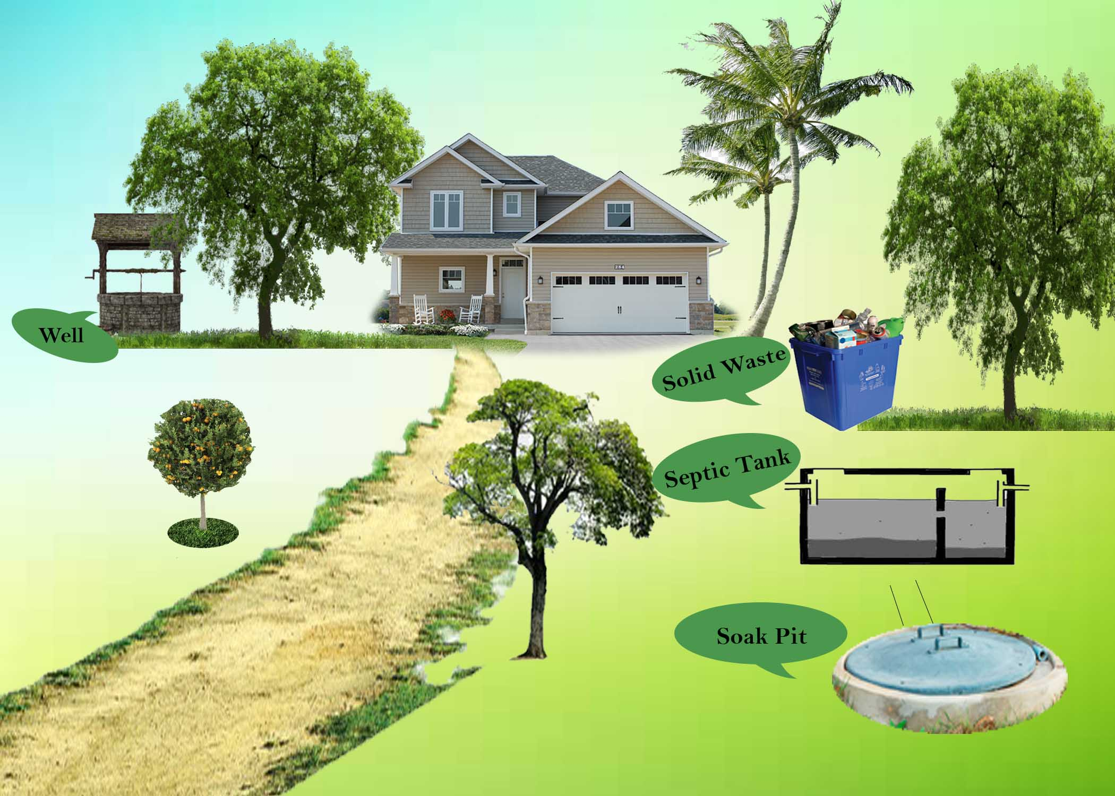
House and the surroundings

Slide 11
House and Surroundings
Well /Borewell
Septic tank / leach pit / other pits for excreta disposal
Disposal of solid waste
Disposal of liquid waste
Waste sources from nearby houses / other establishment
Pollution from non point sources
All the household waste to be disposed in their own land

Slide 12
Environmental planning of house and surroundings
1. There should be enough plants around the house to absorb Carbon dioxide and produce oxygen
2. Plants also absorbs a portion of the waste water during its growth process
3. Use septic tank for disposal of human excreta especially in water logged area., only if the maximum water level is low then only pits can be provided for disposal of excreta

Slide 13
Continued
4. Always ensure absence of organic matter in the well water to avoid its ill effects
5. Liquid waste to be disposed through soak pit so that there is no ingress of waste water in to the well
6. Solid waste is to be disposed through separation, recycling or biodegradable processes

Slide 14
Continued
7. While fixing the position of waste disposal systems in our house consider the nearby area and the waste disposal systems in the neighbouring houses and other establishments
8) Existence of upland waste source is not suitable for the water source to remain safe
9) Try to keep maximum distance between the well and waste source irrespective of the LSGD restriction

Slide 15
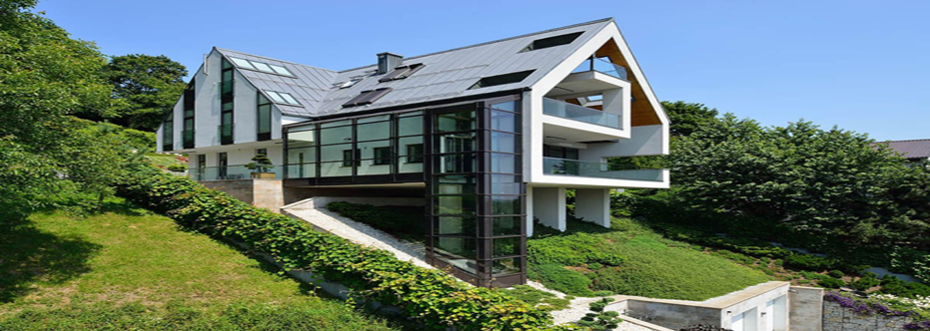
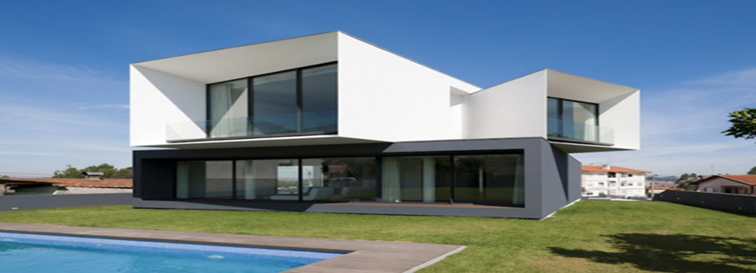
Eco friendly &Eco enemy house

Slide 16
Well maintenance
a) The premises of the well should be hygienic and clean
b) Unused wells using for dumping of waste is highly dangerous. It will pollute the ground water, should be filled
c) Proper drainage should be there around the well to avoid stagnation of water and intrusion in to the well
d) Use motor with low discharge to limit speedy percolation of water in to the well
e) Avoid polluting sources near the well especially upland

Slide 17
f) Almira and platform around the well is highly essential

Slide 18
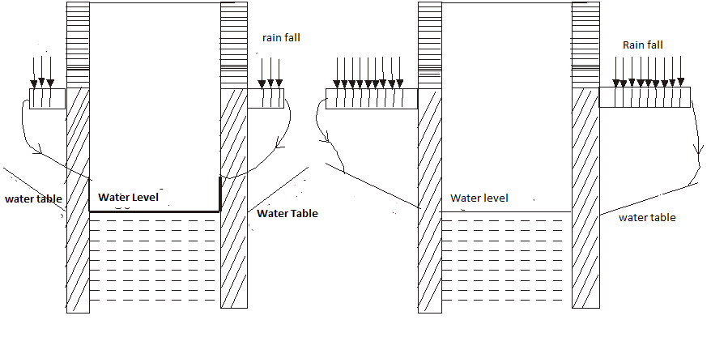
Well platform and Almira
Width of platform less Width of platform less ----- more

Slide 19
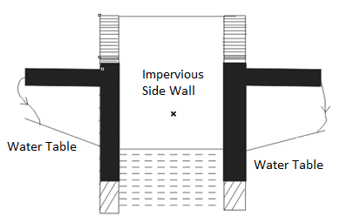
g) provide impervious platform and sidewall to a reasonable depth about 3meters especially in water logged area

Slide 20
Continued
h)Avoid bath rooms attached to the wells
i)Avoid usage of rope and bucket for withdrawing water from the well
j)Avoid incidence of sunlight direct to the well as it can cause growth of algae
k)Do not fix the foot valve to the bottom of the well, instead use flexible ooze so that foot valve can be lowered or raised as per the fluctuation in water level. This is because bottom of the well contains excessive Iron

Slide 21
l)Cover the well to avoid entry of other materials and algae growth
m)Well chlorination periodically as per WHO guidelines

Slide 22
Zones in the state based on Pollution Potential
Water logged area
Coastal area
Thickly Populated Urban area ( towns , cities etc)
Thickly Populated Rural Area
Industrial area
Geographically specific area
Less populated rural area

Slide 23
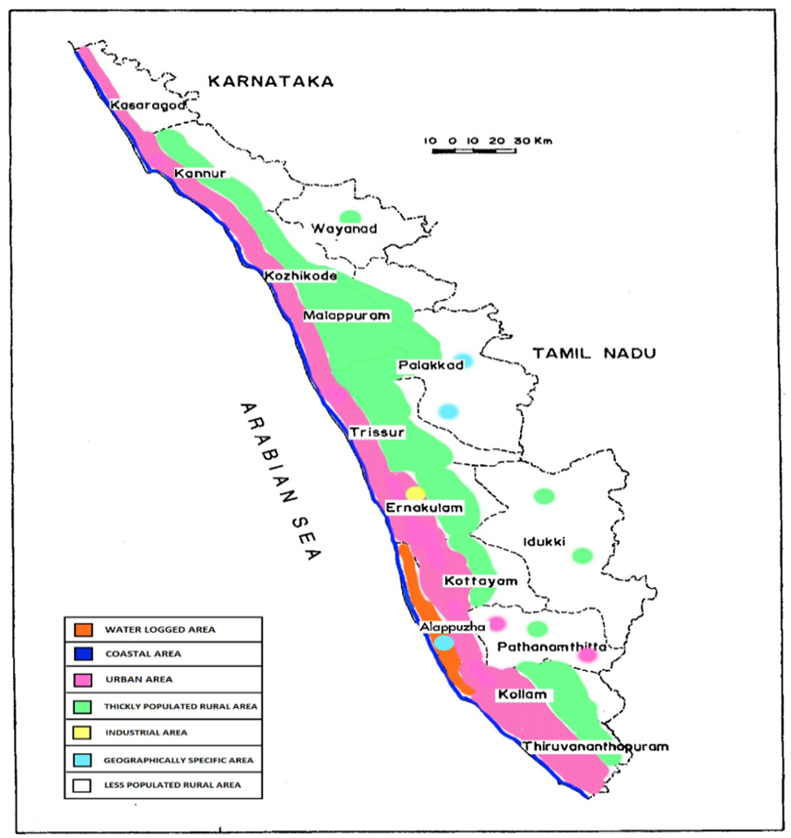

Slide 24
Remedies
Construction of good quality septic tank with inlet and outlet above maximum water level for disposal of human excreta . .
Avoid dumping of solid waste in to the soil.
.Effective water supply system is a solution.
Constant Monitoring of water quality variation is essential
Water logged area

Slide 25
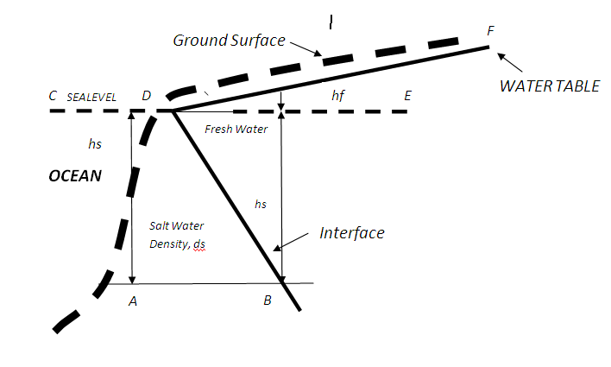
Coastal area
Problem
Sea water intrusion
Solutions
1) Avoid excess withdrawal of ground water in coastal area
2)While digging a well depth should be limited so that only clear water from the top only can be withdrawn
3) Domestic level water treatment kits which can be used at household level

Slide 26
Thickly populated urban area
PROBLEMS
•Presence of coliform bacteria
•Presence of excess Iron in drinking water
•Presence of organic matter
•Low pH and in rare cases high pH
•growth of algae
SOLUTIONS
Constant monitoring for presence of organic matter
In addition to resident population floating population will also be enormous .
.. traditional water sources are likely to be contaminated.
Establishments like hotels , small industries etc will contribute more to the pollution potential .
Well maintenance principles to be more scrupulous

Slide 27
Thickly Populated Rural Area
Problem
Presence of coliform bacteria
•Presence of excess Iron in drinking water
•Presence of organic matter
•Low pH and in rare cases high pH
•growth of algae
Solution
. Pollution potential will be less compared to urban area
. Effective maintenance of water supply system and other water sources are relevant.
Roof top Rain water harvesting and artificial recharge is relevant to control pollution

Slide 28
Industrial area
Problem
Pollution from discharge of industrial pollutants.
. The pollution depends on the type of industry and its waste products.
Public opposition against such industries are common everywhere.
Artificial recharge reduces pollution
Solution
Limitation is the practical difficulty to implement control meures
Role of pollution control board is relevant.
Effective water supply system is an interim solution.

Slide 29
Geographically Specific Area
Problems
Alappuzha and Palakkad districts are having high content of Fluoride in the ground water.
Ground water in certain area in Palakkad district also contains high content of chloride which is due to the presence of saline soil. .
Solutions
Treatment is the only option
Treatment systems are available
Optimize the treatment like only for drinking water fro fluoride removal etc
Government / NGO initiatives to supply water treatment equipment at less cost is ideal
Awareness is essential

Slide 30
Less Populated Rural Area
This is the most healthy area
Well maintenance principles need be observed
However individual problems to be identified and resolved

Slide 31
Government initiatives
open market to avoid exploitation of high profit seeking groups
•Increase the minimum land area requirement for construction of residential buildings should be increased to 10 cents
•
• Creating more awareness among the people on the preservation of water resources and treatment
•Popularizing all types of water treatment equipment and methods among the people

Slide 32
Commercial market for water treatment equipment
Market is large and constantly growing
Many companies like aquaguard , kent,havels ,livepure ,AO smith ,Blue star,water doctor ,and many others
Naturally profit motivated
Imported materials are generally used
Limited research in our country
Many equipment are worthful to be used

Slide 33
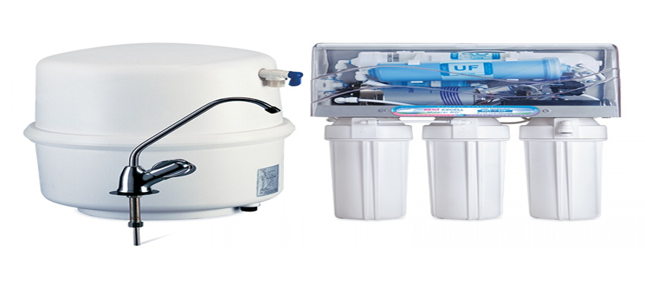
Equipment Based on Reverse Osmosis

Slide 34
Thank you

